Slide 1
These classes are affiliated to the Donkey Breed Society and will be judged in accordance with the DBS rules: Class 1: Best conditioned and turned out Donkey Donkey any age and sex, to be judged 75% condition and 25% turnout. Conformation will not be taken into account. Class 2: Stallion or Gelding, 4 years old or over Stallions and colts must be properly dressed in bridle and bit; the leading rein to be correctly attached to the bit. Class 3: Mare or mare with own foal at foot 4 years old and over or Broodmares 5 years old or over. Foals to be 6 weeks old or over on Show Day and born in the current year. Class 4: 1, 2, and 3 year old Colts or Geldings Entire male donkeys to enter the ring first. Class 5: 1, 2, and 3 year old Fillies Class 6: Championship For the best in-hand donkey open to 1st and 2nd prize winners from the open breed classes only. Champion Donkey Rosette and £10.00, Reserve Champion Donkey Rosette and £5.00. Class 7: Pet Donkey No restriction on the number of donkeys owned. This class to be judged entirely in the suitability of the donkey as a family pet and not as a handy donkey. Conformation shall not in any circumstances be taken into account.
Class 8: Young Handlers An in-hand class for young handlers who have not attained their 16th birthday on the day of the Show. To be judged on the ability of the young handler and not on the conformation of the donkey. Minimum age 3 years.
Class 9: Ridden Donkey Riders 8 years old or under may be led. Competitors are reminded that DBS Rule 5(k) applies concerning weight/height restrictions and BS approved hard hats must be worn. Minimum age 3 years. If the rider is on a lead rein, the handler must be a competent adult 18 years or over and the lead rein must be attached to the noseband.
Class 10: Veteran Donkey For donkeys of 20 years and over.
Class 11: open driving – not to start before 2 pm
Donkeys to be 4 yrs and over
A novice donkey is one that has never one a driving class
Entries close:
25th October 20
Judging starts:
9am
Judge:
tbc
Entry Fees:
£10.00 per class
Where:
PLECK BARN , Dorchester, Higher Ansty, Dorchester DT2 7PU

Slide 2
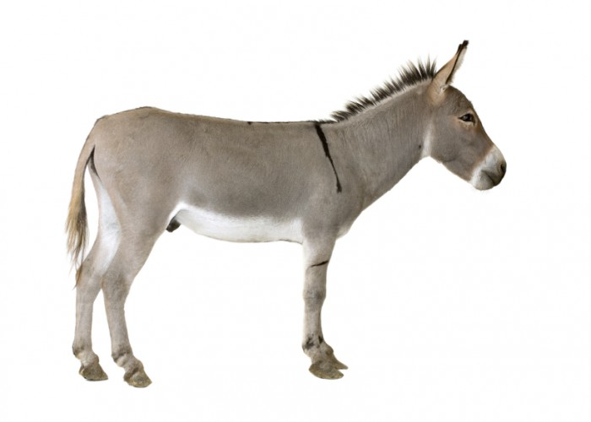
WINTER SHOW
RULES
(a) No person may deliberately enter or show a donkey under a Judge who is known to have either owned, bred, leased, sold, produced, prepared or shown that donkey. No donkey should be entered or shown under a judge who currently owns or leases the sire of that animal or owned or leased the sire at the time of covering. The breeder is the mare owner. In the case of leased donkeys, DBS certificates and awards will only be presented to donkeys that are leased from fully paid up members of the Society. This rule only applies to Breed and Driving classes.
(b) Entering one donkey and exhibiting another is not permitted.
(c) Donkeys entered in the following classes (more fully described under Recommendations for Donkey Classes) must be four years old or over: (A) Stallion (in-hand); (B) Gelding (in-hand); (C) Mare with/without Foal* at Foot (in-hand); (2) Driving Classes; (4) Ridden Donkey; (5) Pet Donkey. *Foal to be six weeks old or over on day of day; foals to be the progeny of parents who were at least four years of age at conception.
(d) No nomination entries are permitted.
(e) Once a Judge has commenced judging a class, a donkey may not be led, ridden or driven in or out of the ring without the permission of the Judge.
(f) A Judge will ask a competitor to leave the ring if either they or their donkey act in a dangerous or improper manner.
(g) Whips/canes carried in the show ring to be no longer than 30" (75cms) overall (not applicable to Driving classes).
(h) DBS members must carry their DBS membership cards at all times when showing for production on request in order to receive DBS rosettes.
(i) Stallions and entire colts must be properly dressed in bridle and bit with the leading rein correctly attached to the bit. No person under the age of 18 may handle an entire donkey (foals excepted). No entire male donkey is allowed to compete in any children's classes (except Driving;see Rule 5(n)(i) ).
(j) Mare with own foal at foot Class: superficial blemishes of a non-hereditary character do not necessarily bar the mare from being awarded a prize in such a class.
(k) There shall be no objection to a foal under six months of age being exhibited without its dam providing that the dam is present on the showground, but this rule shall not apply to an orphan or bottle-fed foal supported by an appropriate letter from the veterinary surgeon.
(l) Ridden Classes: Donkeys entered must be four years old or over and must have a correctly fitting bridle and saddle. All riders must wear an approved (PAS015 or VG1) correctly fitting hard hat to conform to the current BSI standards. Riders in Leading Rein classes: minimum age 3 years. In Leading Rein Classes, donkeys to be led by a competent adult (18 years and over); leading reins to be attached to the noseband.
A FUN DAY WITH OUR PRECIOUS DONKEYS
Entries close:
25th October 20
Judging starts:
9am
Judge:
tbc
Entry Fees:
£10.00 per class
Where:
PLECK BARN , Dorchester, Higher Ansty, Dorchester DT2 7PU

Slide 3
ENTRY FORM 1ST NOVEMBER 2020
CLASS NO | NAME OF RIDER/HANDLER/DRIVER | NAME OF DONKEY | DBS MEMBER | FEE
 |  |  | TOTAL
PLEASE RETURN ENTRY TO – Mr C Harris The Stables Red lane poundisford Somerset TA3 7ad
PLEASE ADDRESS CHEQUES TO Mr Harris

